Slide 1

Benford's Law Analysis on Star Dataset
Team - Benford Busters
Exploring digit distributions across galactic, equatorial, visual magnitude data and more.
Team Members
Kundan Gupta - Data Analyst
Rohan Kumar - Data Analyst
Yashraj Chouhan - Content Generator
Mridul R - Research Coordinator

Slide 2
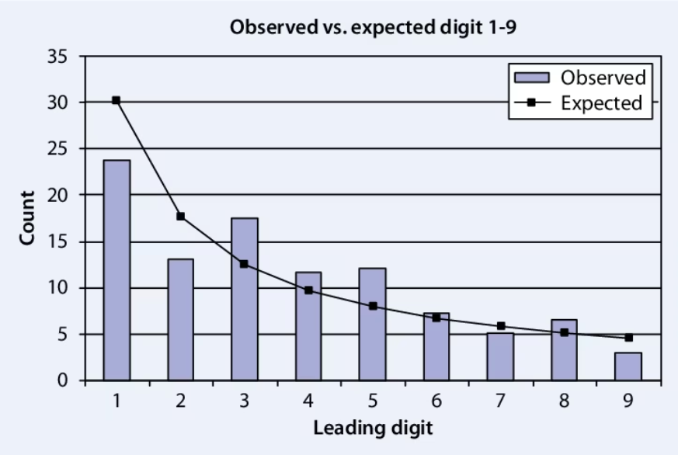
Understanding Benford’s Law
What is Benford’s Law?
Benford’s Law describes the frequency of leading digits in natural datasets.
Smaller digits, especially 1, appear more frequently than larger digits.
Mathematical Formula
P(d) = log10(1 + 1/d)
Where P(d) is the probability and d is the leading digit.

Slide 3
Dataset Overview
Statistic
Galactic Longitude
Galactic Latitude
Parallax
Error
Distance (ly)
Count
150.000000
150.000000
150.000000
150.000000
150.000000
Mean
147.713333
204.814667
-21.908667
31.825267
389.640000
Std
87.905558
103.441957
18.939483
74.363499
458.451995
Min
1.000000
0.900000
-80.700000
1.020000
4.000000
25%
65.250000
127.200000
-31.775000
6.677500
117.250000
50% (Median)
150.500000
219.150000
-15.350000
14.465000
222.500000
75%
223.750000
288.625000
-7.000000
27.895000
490.000000
Max
296.000000
359.200000
-0.400000
742.120000
3000.000000
Note: Dataset includes 150 stars with detailed spatial and measurement statistics.
Key stats: Distance ranges from 4 to 3000 light years.

Slide 4
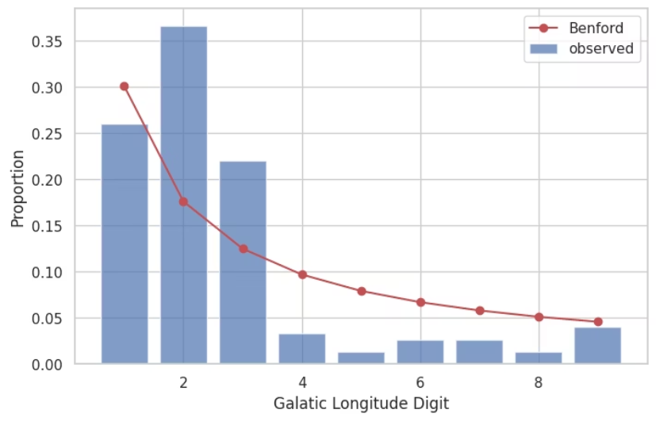
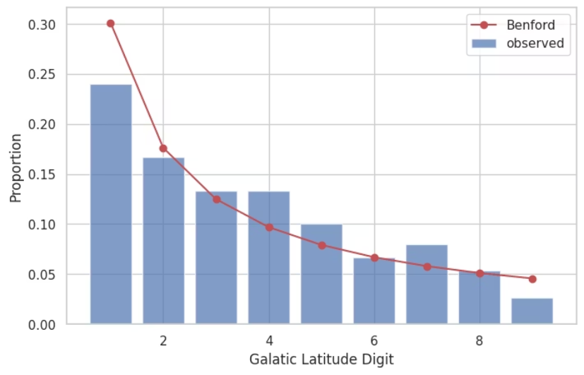
Galactic Coordinates and Benford’s Law
Galactic Longitude
Galactic Latitude
Does not follow. Digit 2 (36.7%) is much higher than expected (17.6%), and digit 1 (26%) lower than expected (30.1%). The pattern diverges substantially.
Does not follow. The distribution is roughly uniform (each digit ~10–24%), starkly different from the logarithmic Benford curve.
Graph: Galactic Longitude digit proportions
Graph: Galactic Latitude digit proportions

Slide 5
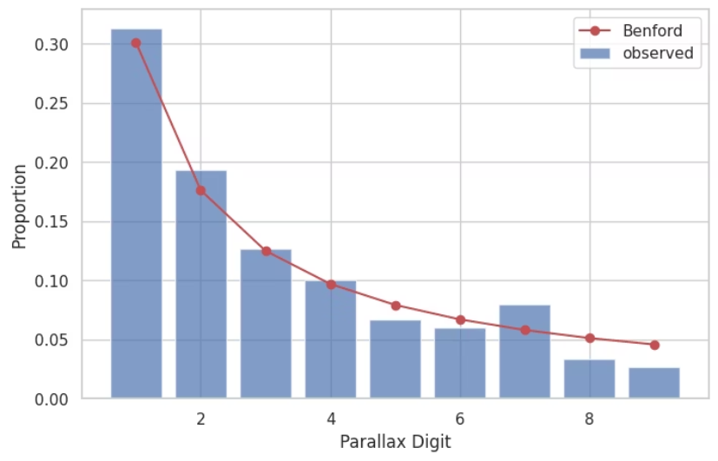
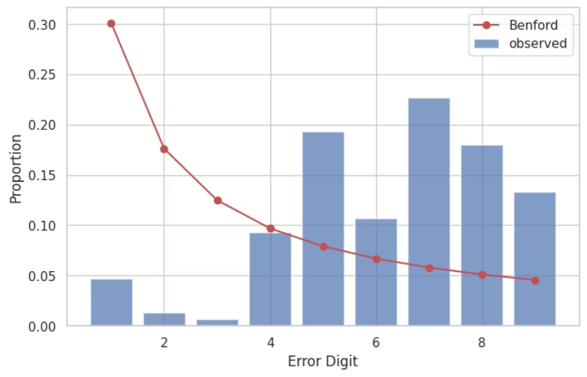
Parallax & ErrorAnalysis
Parallax
Error
Follows Benford’s Law. Digit 1 (31.3%), 2 (19.3%), and 3 (12.7%) closely match expected values (30.1%, 17.6%, and 12.5%).
Does not follow. The distribution is skewed, dominated by digit 5 (~19.3%) and digit 4 (~9.3%), while digits 1–3 occur rarely.
Graph: Parallax digit proportions aligned with Benford’s Law
Graph: Error digit proportions indicating measurement consistency

Slide 6
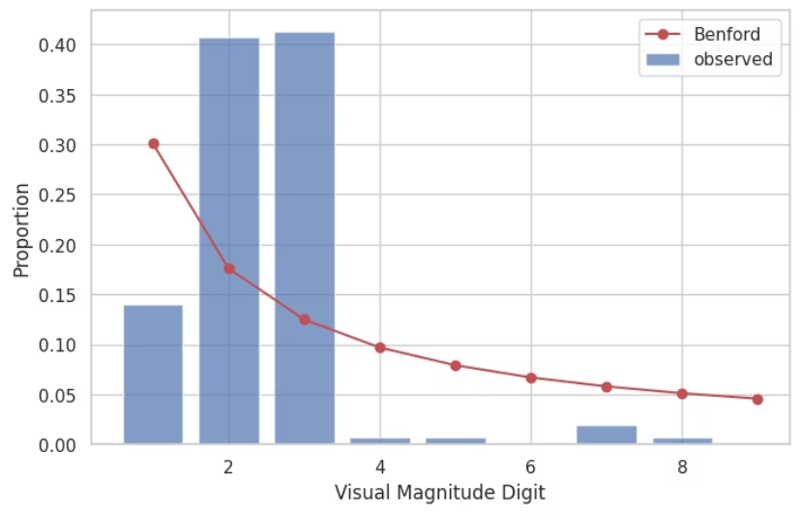
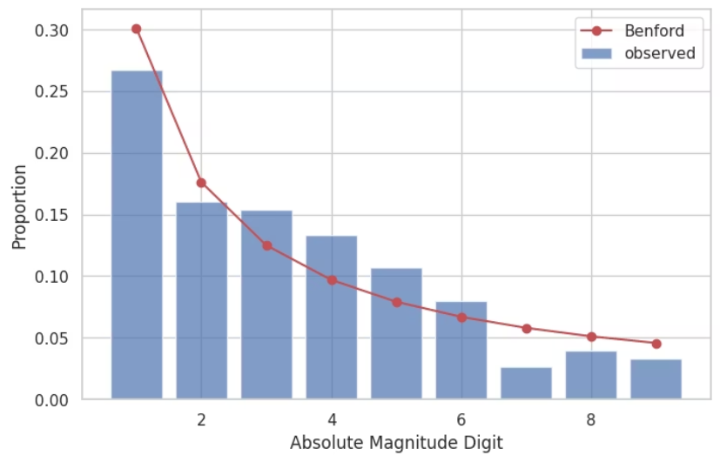
Visual & Absolute Magnitude Analysis
Visual Magnitude
Absolute Magnitude
Partially follows. Digit 1 leads with ~28%, fairly close to Benford’s 30.1%, but digits 2–5 show inconsistent drops, making the match imperfect.
Partially follows. Though a logarithmic scale is used, the distribution of digits is uneven due to value clustering, especially around certain magnitudes.
Graph: Visual Magnitude digit proportions
Graph: Absolute Magnitude digit proportions

Slide 7
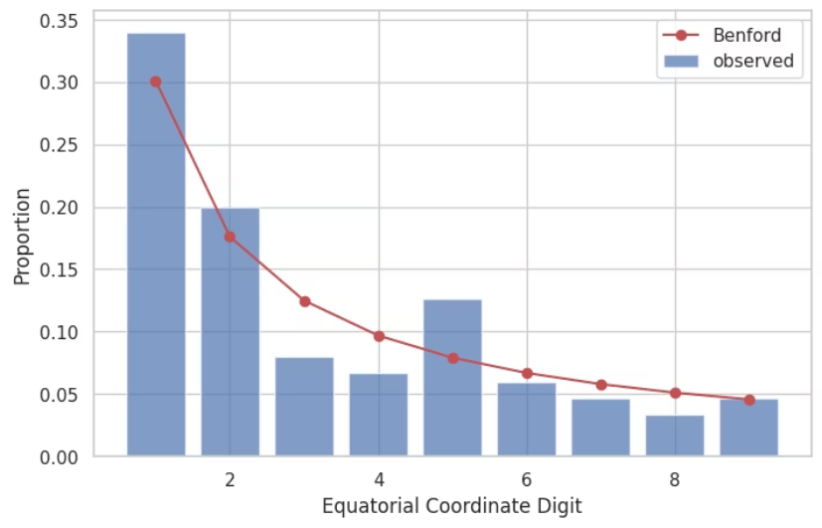
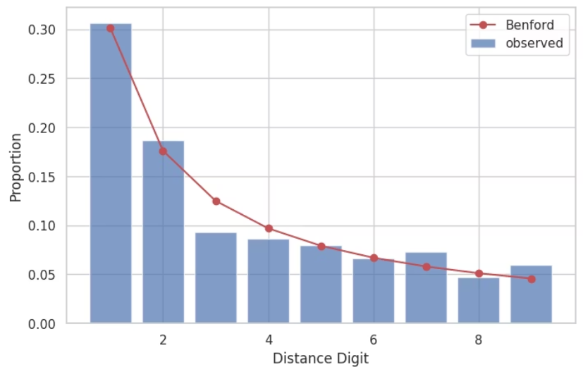
Equatorial Coordinates & Distance Analysis
Equatorial Coordinates
Distance (ly)
Does not follow. Leading digits are evenly spread due to fixed angular ranges, resulting in a uniform—not logarithmic—distribution.
Follows Benford’s Law. Digit 1 (30.7%) and 2 (18.7%) closely align with the Benford model; the overall trend maintains logarithmic decay.
Graph: Equatorial Coordinates digit proportions
Graph: Distance digit proportions

Slide 8
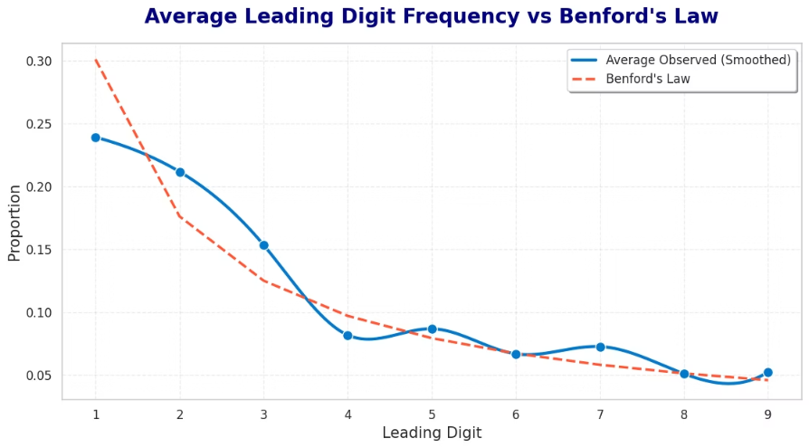
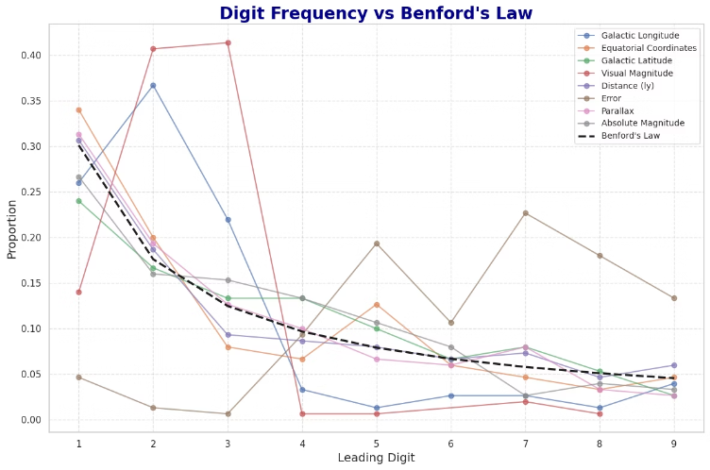
Data Validation Summary
We applied Benford’s Law to various columns in the star dataset to check for natural data distribution. Most columns, like Galactic Longitude and Distance, closely followed the expected pattern, suggesting reliable data. Minor deviations in some fields may be due to rounding or limited variation. Overall, Benford’s Law proved useful in validating the dataset.

Slide 9





Team Contributions
Kundan Gupta
Rohan Kumar
Yashraj Chouhan
Mridul R
Data preprocessing & exploration
Extracted digits for 4 columns
Analyzed remaining dataset columns
Overall analysis & mean distribution comparison
Built Benford comparison plots
Created get_first_digit() function
Explained Benford’s Law mathematically
Created subplot grid of digit distributions
Added summary, conclusion, intro, and thank-you slides
Prepared dataset overview slide
Compared Benford's expected values
Common Contribution: GitHub clean commits, full .ipynb, PPT Generation and detailed README file

Slide 10




Project Links & Thank You
Github
​https://github.com/Kundan-CR7/Benford-Buster​
GoogleColab
​https://colab.research.google.com/drive/1DzQL7kAWkR99hHapwWpKLqYT3ShXDSiQ?usp=sharing​​
Dataset
https://drive.google.com/file/d/12vHkcBOK_MjMlGHgJ7RklWJjOW3X1Ihd/view​

